Slide 1
SAP BTP Extension Suite Training
Day 15
Anubhav Oberoy
www.AnubhavTrainings.com
Follow excellence with sheer passion

Slide 2


DISCLAIMER
The training content and delivery of this presentation is confidential, and cannot be recorded, or copied and distributed to any third party, without the written consent of Anubhav Trainings

Slide 3
Agenda – Day 15
01
Add another UI inside app
02
Working with Authorization
03
Serverless Fiori Apps

Slide 4
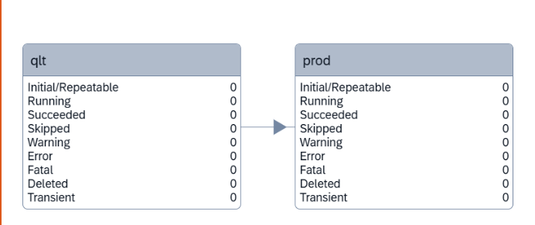






GitHUB
webhook
CI/CD Service
2
3
Ctms-ms
download
build
Deploy
Release
1
Cloud Transport Management
Btp-cred
BTP Sub-account
dev

Slide 5










Serverless Fiori app
Anubhav, in my company we have multiple Fiori teams, but only one cap team. Cap team develop backend db and services, Fiori teams will create MULTIPLE Fiori apps on same cap services. What is the best practice and design.
If we want to build 5 Fiori apps, do we add all 5 apps in same mycapapp folder, it will make our project very bulky.
As a engineer I have been taught that, we should separate our UI from API/DB. Because UI changes are so frequent as compared to backend change. If combine ui and backend in same project, even there is a small label change on ui, it require whole app mtar to be built and deployed. cf deploy mycapapp-ui
Best practice is to keep our UIs separate in different projects yet backend is same.

Slide 6
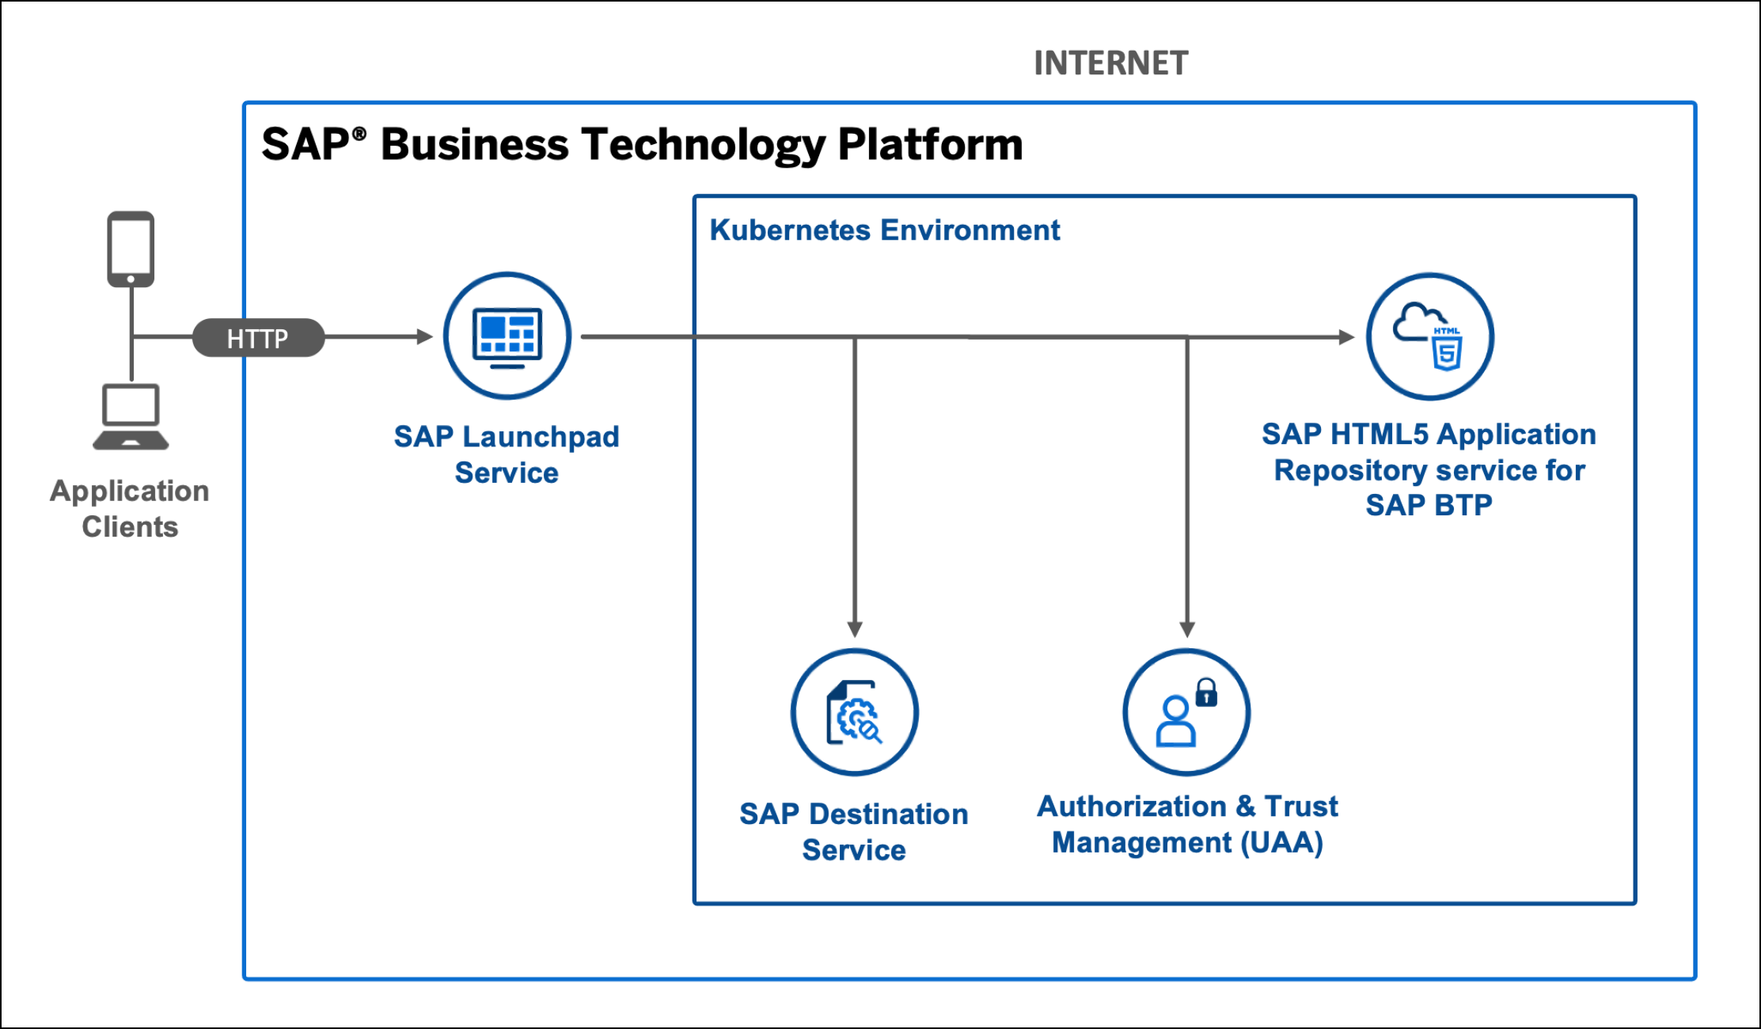
Serverless Fiori App

Slide 7
Serverless Fiori Apps
Hi Anubhav, when we have multiple FIoRI apps in the same capm service,
we have to create roles for all the FIoRI apps in the same xs-security.json and have to assign it to relevant app users right ?
Since these are independent apps, the security also needs to manage independently. Each app has its own xs-security file.
Also when we build multiple fiori apps, we will have multiple ui micro services for the same cap app right ?
No, CAP app has its own microservice. You have these loosely coupled Fiori apps which are indepent apps.
cds outbox messages pls show us how we can have different message displayed to the user.I checked in the google,but couldn't find example on it
Let me explore and come back ☺
one doubt regarding HDI microservice.with CICD and CTMS we are anyway deploying in Dev again and then release to QA. Can we avoid manual deployment first ( Mickey service ) .
Yes, you can but if you don’t do mickey, how you test whether your app after deployment will work with HANA or not?
Use CTMS to deploy in dev as well , test and then release to QA. is there any disadvantage if we do this way.
No

Slide 8
Fiori on Cloud Recipe ingredients 3X3
Modules
Our application (html5 module) – it is our actual Fiori app, when we build the mta_archieve, this will also package all the Fiori app content in a zip file.
HTML5 Content Deployer (app content)– this module will be used to take the zip file of our Fiori app and usage the html5-repo-host service and store our app in BTP HTML5 Repository.
Destination Content – The module will use the destination service and creates the destination for html5-repo-host service and auth (xsuaa) service which later will be used by managed app router hence by build workzone and our app.
Resources
html5-repo-host service – this will be used by Build workzone and managed app router to load our Fiori app deployed in html5 repository @ Runtime when user tries to load our app.
Destination-service – this service will contain all the destinations inside and help app and managed app router to locate other services @ Runtime
Auth service (xsuaa) – so our app can call the XSUAA for JWT token for authentication.
Managed App Router (built-in in BTP) – it is a built-in, FREE, app router provided by SAP in BTP. Which is responsible to communicate between all microservices of our Fiori UIs. It is used by build work zone (Fiori Launchpad). There is also a successor of managed app router called as Application frontend service.

Slide 12

What We Did
Let’s Summarize

Slide 13

www.anubhavtrainings.com
Thank You
End of Day 6

Slide 14


We’re committed to empower you to be
#FutureReady
through powerful training solutions.
We build the workforce of the future.
260+
Corporate Clients
60,000+
Learners Trained
26000+
Learners Placed
FREE WEBINARS
Sign up for free webinars with industry experts every fortnight!
Enroll Now!
Contact us today!
https://anubhavtrainings.com

